Slide 1


Intro to Wireshark
CS 6043: Networking
Sadat
Ph.D. Student, Multimedia Networking & Computing Lab

Slide 2








What is Wireshark?
A network protocol analyzer or a packet sniffer.
Captures network packets and tries to display that packet data as detailed as possible.
Has a GUI front-end and many information sorting and filtering options
Available for almost all current desktop and server OS.

Slide 3
Why use Wireshark?
It is the de facto standard in network analyzer tools (500k dl/mo)
Troubleshooting network problems (e.g. VOIP issues)
Detecting security problems (e.g. DoS attack)
Debugging protocol implementations
Learning network protocol internals
One of the best open source packet analyzers. It’s Free.
What it CANNOT do
It is not an intrusion detection system
Cannot be used to map out a network
It does not generate network data; passive tool

Slide 4
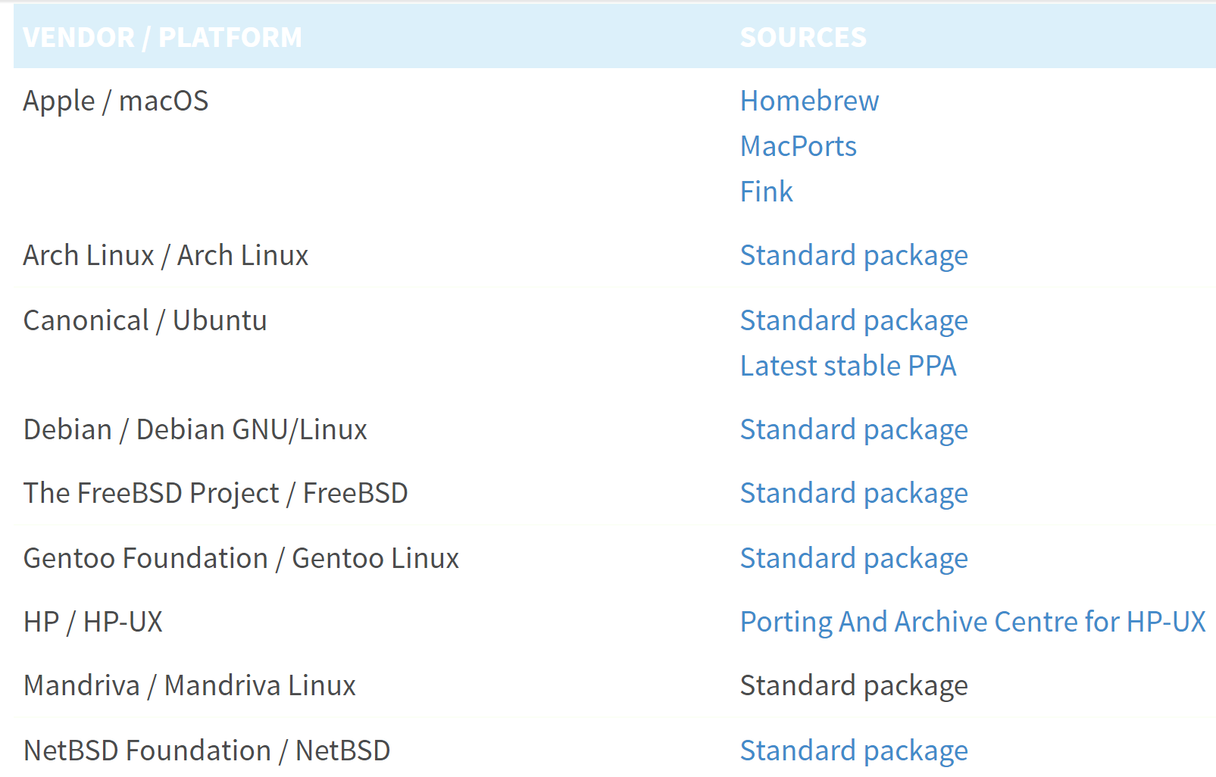
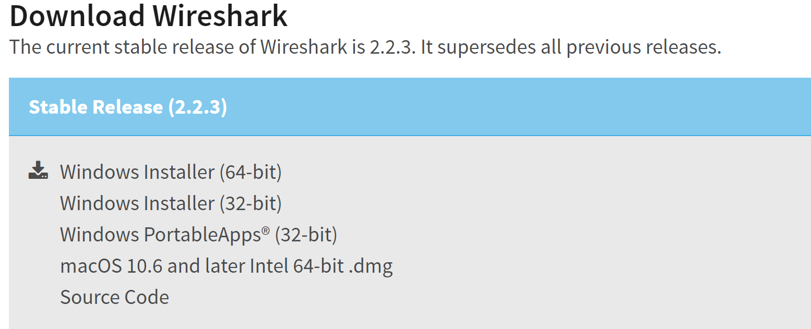
Installing Wireshark
Installation Files https://www.wireshark.org/download.html
Or just google “wireshark download”
Remember to install WinPcap/LibPcap. Otherwise Wireshark won’t work.
Windows & Mac OS users can directly install Wireshark from .exe or .dmg files.
Mac users also need Xquartz to run Wireshark. Link: https://www.xquartz.org/
UNIX/Linux installation: Scroll down to get “Standard Packages” for each distributions.
You can also install it from your Software Center (if applicable)

Slide 5
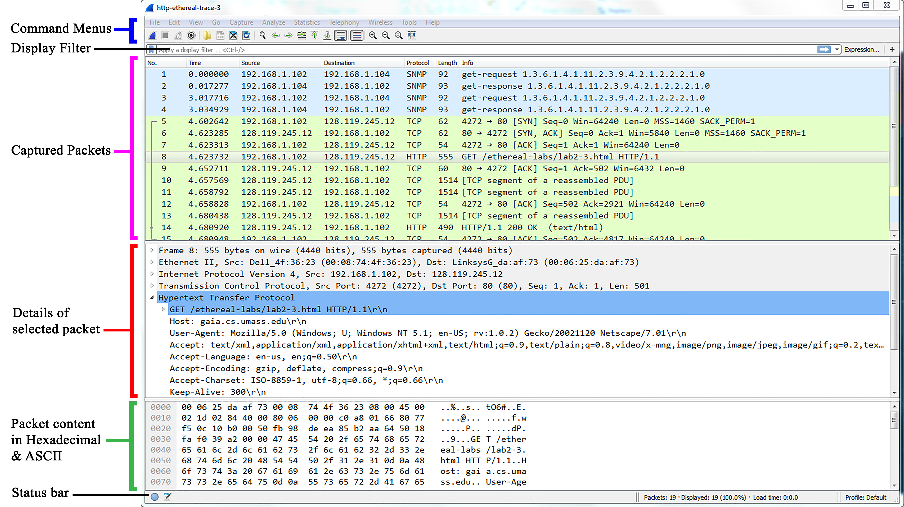
Wireshark GUI
Fig: Wireshark Graphical User Interface, during packet capture and analysis

Slide 6
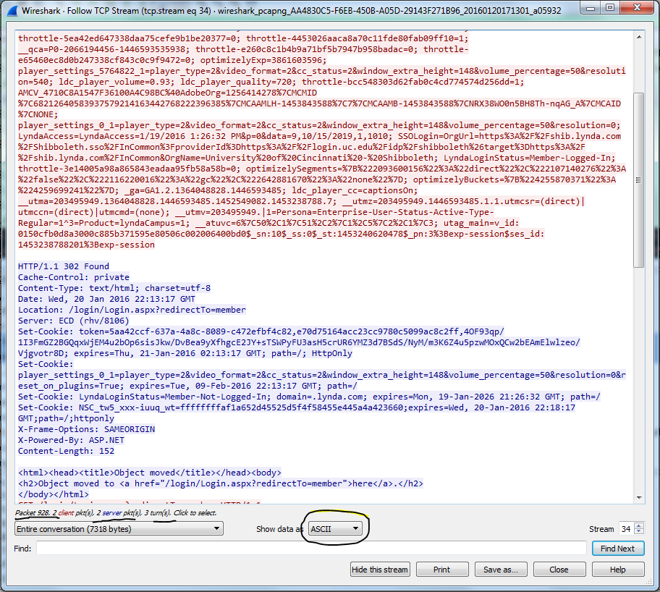
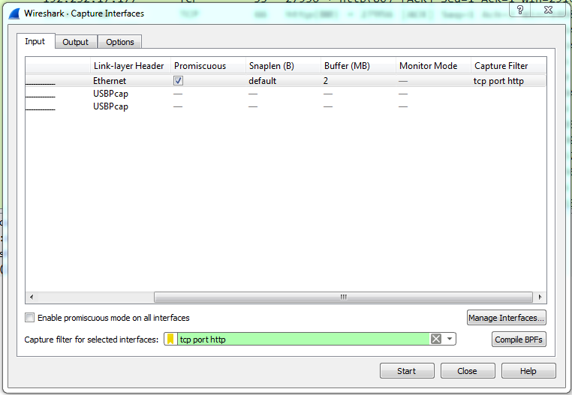
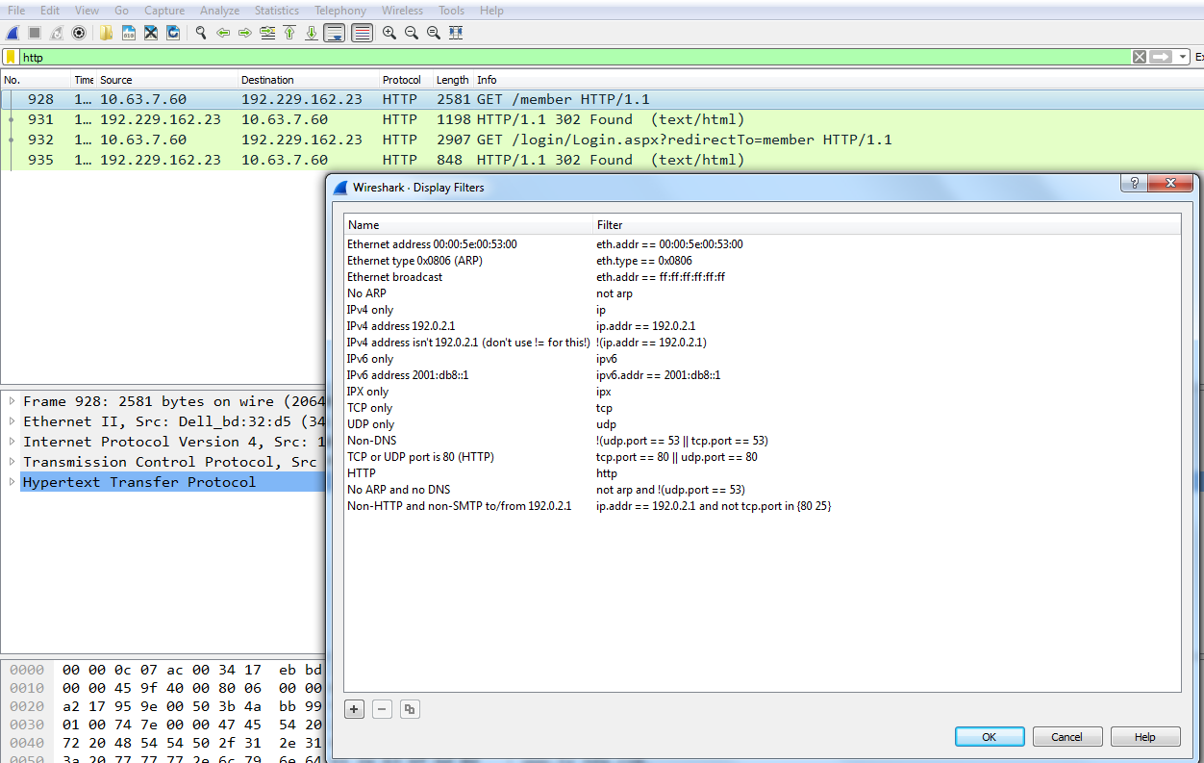
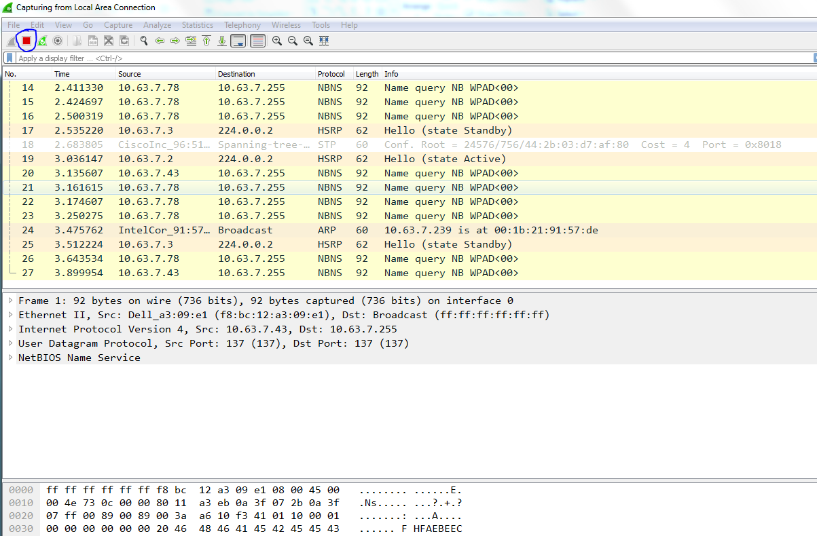
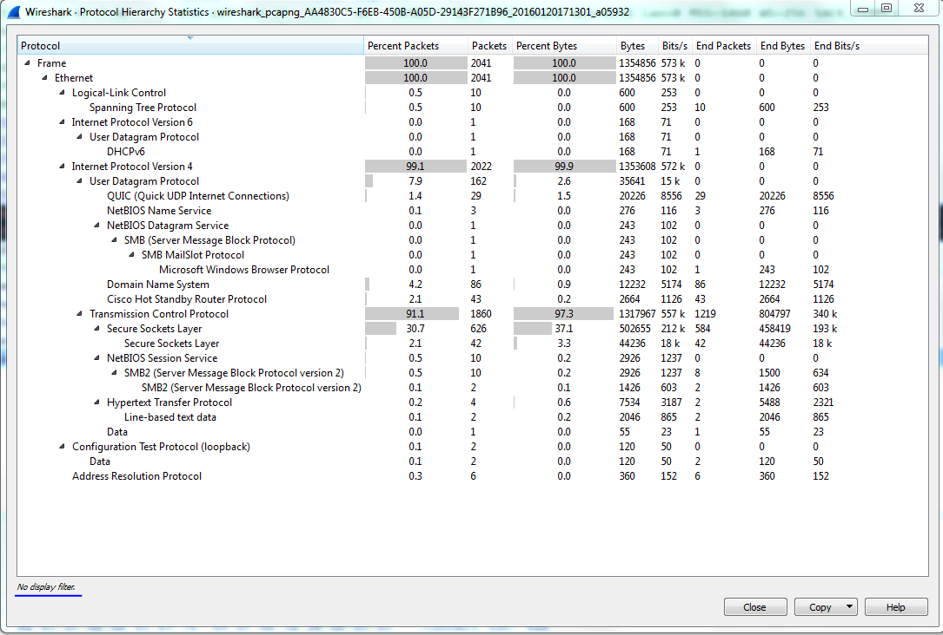
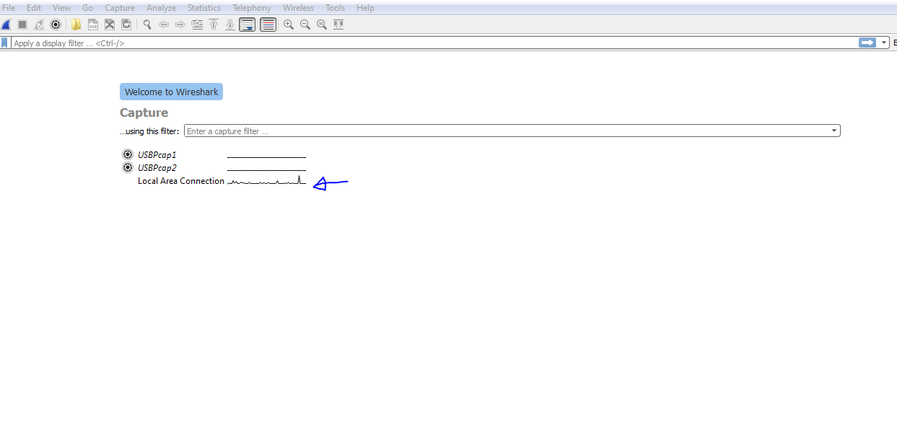
Demo
Interface selection
Capture packets (w/o filter)
Apply capture filter
Apply display filter
Analyze packets and protocols
Protocol hierarchy
Follow TCP Stream

Slide 7
Practice Questions
PDF: http://bit.do/TestPDF
Traces: http://bit.do/Traces1
Download to your laptop
DNS
HTTP
Alternative link: http://bit.do/e95bt
Notes:
Alternative link: http://bit.do/6043trace1

Slide 8
Learn Wireshark
Wireshark.org: Resources and Documentation
https://www.wireshark.org/docs/
LinkedIn Learning: Troubleshooting Your Network with Wireshark
https://www.linkedin.com/learning/troubleshooting-your-network-with-wireshark
Wireshark Jumpstart Event Notes
http://wiresharktraining.com/files/wiresharkjumpstartnotes_combs-chappell_march2013.pdf
Practical Packet Analysis by Chris Sanders
2nd Edition, ISBN: 978-1-59327-266-1
YouTube

